Slide 1


How Retrofitting Buildings Prevent Earthquake Deaths

Slide 2
How do Earthquakes Make Buildings Collapse
When energy is released from an earthquake they turn into waves just below the earth's surface. These waves force energy into buildings foundation and up the building in an attempt to dissipate the energy.
This energy cause shaking and vibrating which end up 'attacking' weak spots in foundation and in the rest of the building causing failure which inevitably results in collapse

Slide 3
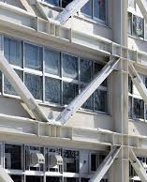
What is Retrofitting
Retrofitting is the act of adding structural features to a building in order to make it more safe. This isnt just used for earthquakes but any hazard that a building isn't prepared for.
In the context of an earthquake there are a few many areas that retrofitting is used: the foundation of a building and weak points in the upper parts of the building.
Foundations are the first to be hit with seismic energy and are required to absorb the most of its energy, a poor foundation will simply begin to crack and break apart in the event of an earthquake.
The rest of a building being damaged is dependent on what it is built with any unreinforced buildings will have weak points which will be the first to fail as it is unable to absorb energy safely and instead starts the uncontrollable chain of damage

Slide 4
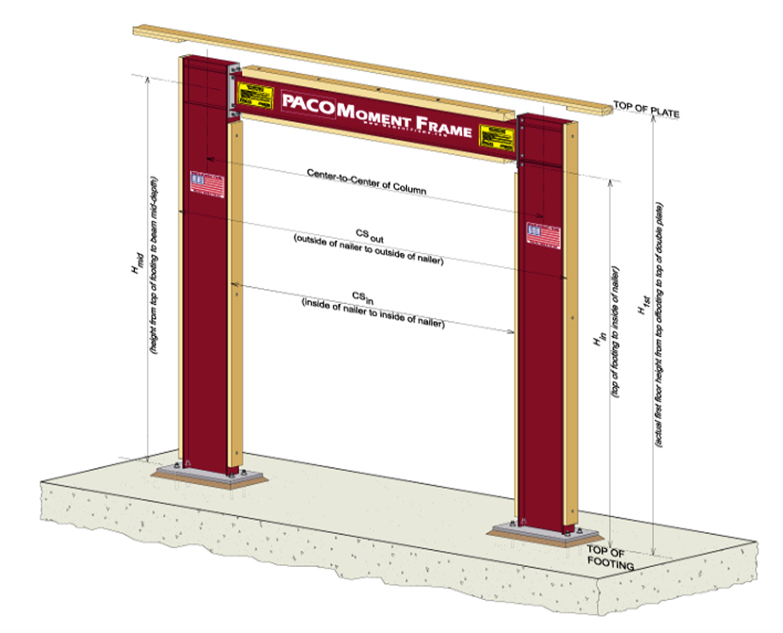
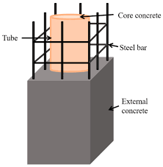
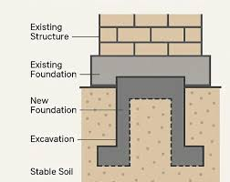
Methods of Retrofitting for Earthquakes
Steel Moment Frames:
Steel is imbedded in the foundation so that it can absorb as much energy as possible, this is preventing swaying and is ideal for buildings that aren't able to withstand much lateral force.
Column Fortification:
Columns within the building are reinforced with metal as they are much better at absorbing this energy without damage so for buildings that are mostly concrete or brick this is the perfect addition
Underpinning:
Resecuring a building to its foundation is needed for buildings that are only secured using mortar or other joining material that can be easily disconnected with the force of an earthquake

